Slide 1

Traffic Advisory Committee
Jaime Rodriguez, Consultant Traffic Engineer
Public Works Department
June 19, 2025

Slide 2
Today’s Topics
Guest Speakers
Office of Traffic Safety Grants (Burt Iles, Police Dept)
Resident Traffic/Parking Requests 2025
Current and Future
Roadway Restriping Only Projects
Marin St (Auto Center Dr to Freedom Blvd)
Tuttle Ave (E Lake Ave to McKenzie Ave)
Westridge Dr (Airport Blvd to Technology Dr
Airport Blvd (West of Loma Prieta Ave)
Active Transportation Projects
Citywide LED Streetlight Replacement
Citywide Vehicle Speed Feedback Signs
Pedestrian-Activated Flashing Beacons
Grant Projects
SS4A Citywide Traffic Study
Capital Improvement Program (CIP) Projects
Annual Street Resurfacing

Slide 3
Neighborhood Traffic Management Program Flow Chart
STAGE 1
STAGE 2
STAGE 3
Traffic
Calming
Advisory
Committee
Minor
Traffic Calming
Projects
Major
Traffic Calming
Projects
Resident
Request
Data
Collection
Analysis
Data Collection
Analysis
Engineer
Field
Review
Community
Outreach
Community
Outreach
Traffic
Operations
Improvements
RESIDENT
PETITION
TCAC
Budgeting
Design
Community Input
Complete in 6 Months
Monitor for up to 6 Months
SILENT
PETITION

Slide 4
Resident Service Request Summary, 2025
Council District:
1
2
3
4
5
6
7
Service Request Categories:
11
0
6
31
8
Traffic Operations
Traffic Calming
Crosswalk Safety
Traffic Signals/Streetlights
Parking
Service Requests:
6
5
4
14
14
10
6
T.C. Petitions:
59 Resident Service
Requests in 2025
Work Orders Generated:
13
1
2
2
1
37
City Public Works
Electrical Contractors
Striping Contractors
Planning
Caltrans
No Action

Slide 5
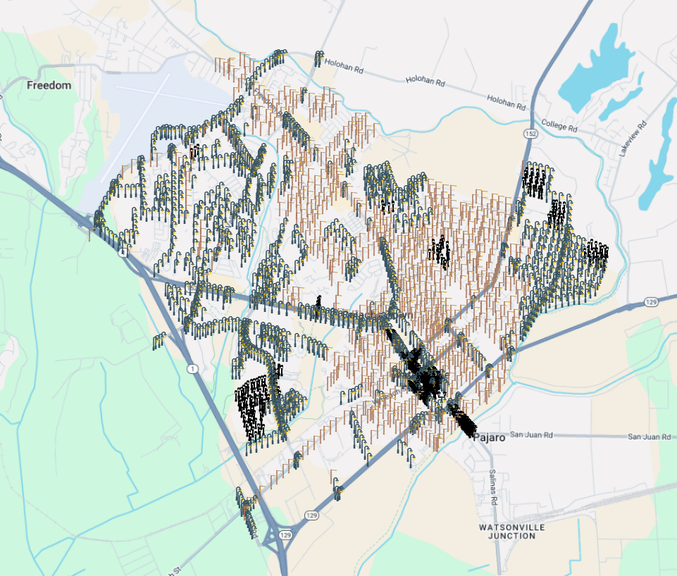
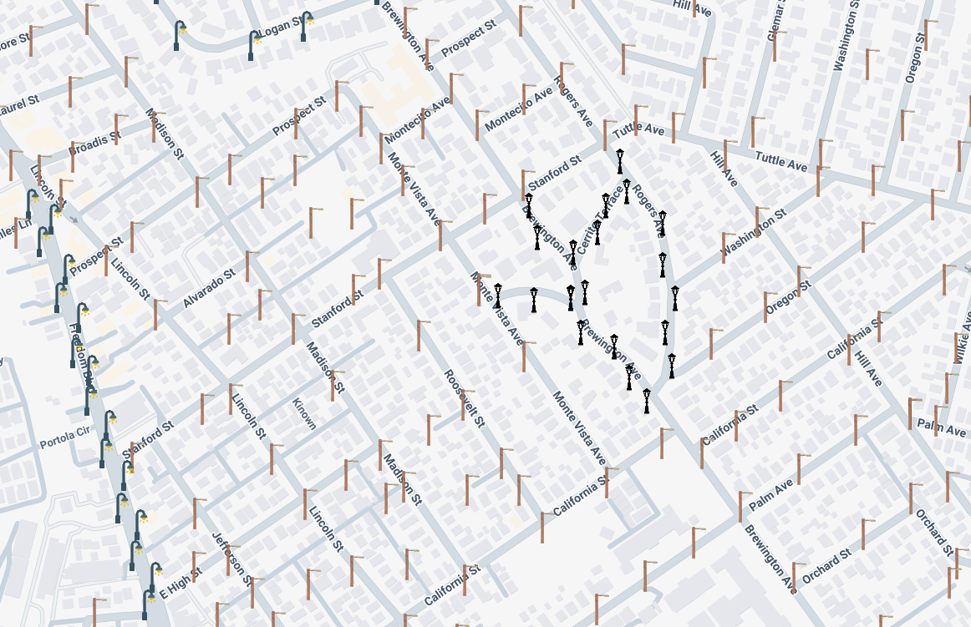
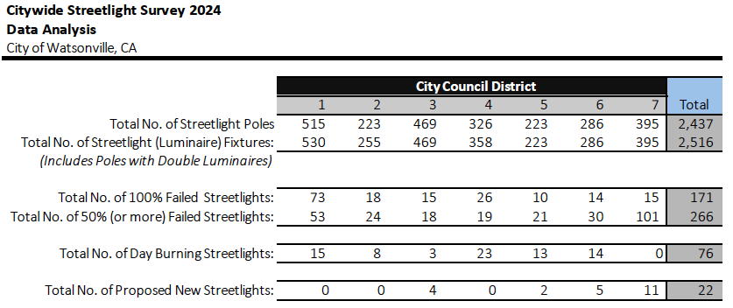
Watsonville – Citywide LED Streetlight Replacement
Target Completion: Fall 2025 (November)
Airport Blvd
Lake Ave
Stanford St
Freedom Blvd
Green Valley Rd
Main St
Freedom Blvd
Brewington Ave
Riverside Dr
Ohlone Pkwy

Slide 6
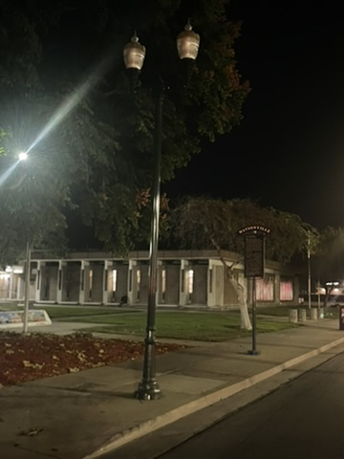
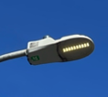
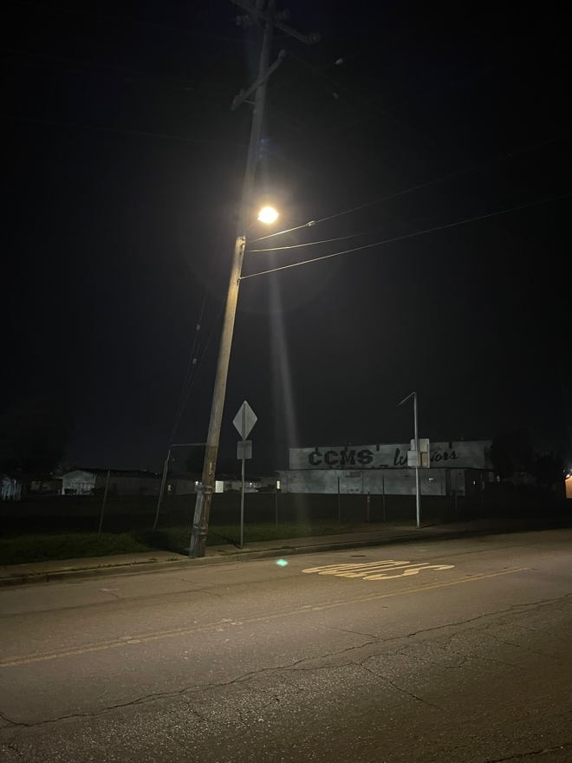
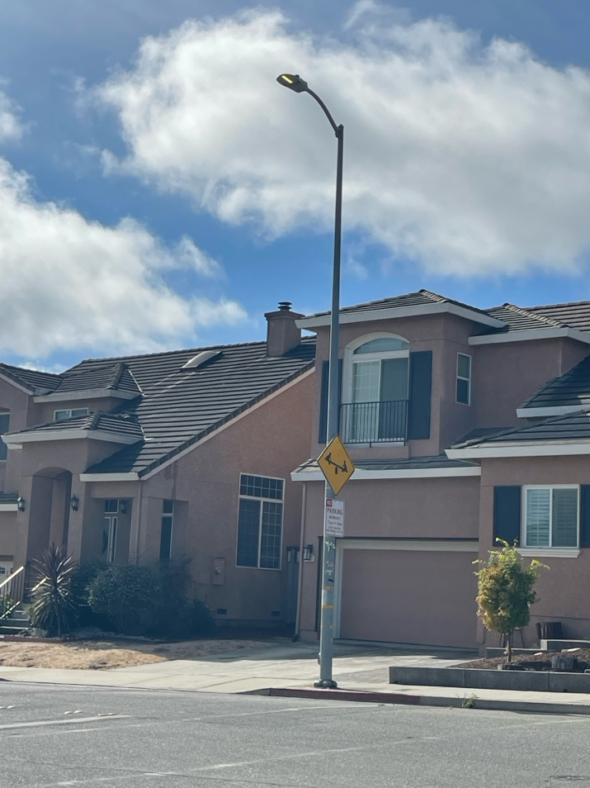
Watsonville – Citywide LED Streetlight Replacement
Target Completion: Fall 2025 (November)
Next Steps in 2025:
June Bid for LED Streetlight Modules
Release RFP for Installation Services
July City Council Award (July 8) for Materials
City Council Award (Fall) for Installation (Tentative for Aug/Sept)
Sept Start of Material Delivery
Oct Target Begin Installation
Nov Field Installation Complete
Dimming and Failure Monitoring Technology Under Consideration, Pending Cost
Failure
Day Burner
CREE Pilot Project

Slide 7
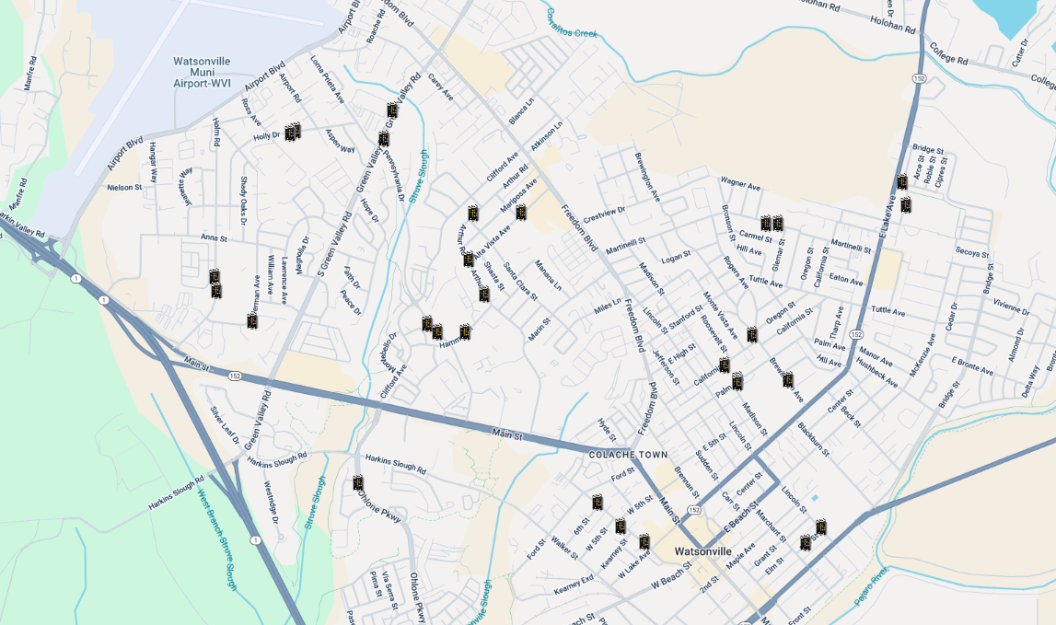

Vehicle Speed Feedback Signs Replacement
Target Completion: Summer 2025
Ex. Speed Signs in City:
29
Failed Signs:
19
66%
Signs Purchased, On Hand
Contractor Selection Active
Construction: Summer 2025

Slide 8
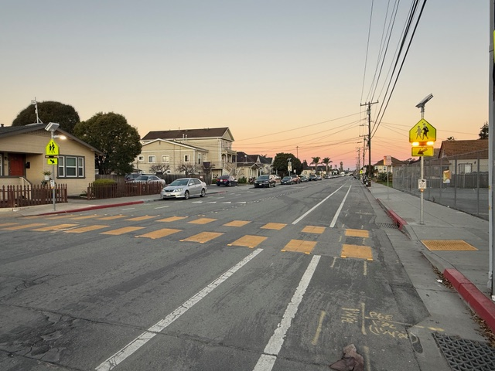
Pedestrian-Activated Flashing Systems
Target Completion: Summer 2025
Newly Installed Pedestrian-Activated Flashing Beacons
Ohlone Pkwy & Kingfisher Dr
Rodriguez St & Kearney St
Active Projects for New Beacons in Summer 2025:
Airport Blvd & Safeway (Repair)
Harkins Slough Rd & Sunset Vista (Repair)
Harkins Slough Rd & Bayview Dr (New)
Rodriguez St & W 5th St (New)
Martinelli St & McQuiddy School (New)
Green Valley Rd & Carey Ave
(Fall 2025 following active Street Resurfacing)
Rodriguez St & Kearney St
Pedestrian-Activated Flashing Beacon

Slide 9
2025 Paving – Full Reconstruction Projects
Target Completion: Summer 2025
No.
Street
Section
Council District
Status
1
Green Valley Rd
Carey Ave to East City Limit
3, 4, 6
Under Construction, 60%
Work Scope:
Complete Repaving of Street
Bike Lane facility improvements
New Ped-Activated Flashing Beacon at Green Valley Rd & Carey Ave
No.
Street
Section
Council District
Status
2
Bridge St
Blackburn St to Beck St
1, 7
Going to Bid in Summer 2025
Work Scope:
Complete Repaving of Street

Slide 10
2025 Paving – Street Maintenance (Slurry Seal)
Target Completion: Fall 2025
No.
Street
Section
Council District
Status
1
Harkins Slough Rd
Green Valley Rd to Ohlone Pkwy
4
Start in Fall 2025
2
Harkins Slough Rd
Ohlone Pkwy to Blackbird Cir
1
Start in Fall 2025
3
Loma Prieta Ave
Green Valley Rd to Airport Blvd
3
Start in Fall 2025
4
Green Valley Rd
Main St to Pennsylvania Dr
3, 4
Start in Fall 2025
5
Freedom Blvd
Alta Vista Ave to Broadis St
5, 6
Start in Fall 2025
No.
Street
Section
Council District
Status
ALT-1
Kilburn St
Ford St to W 5th St
1
Pending Bid Results
ALT-2
Ford St
Rodriguez St to Walker St
1
Pending Bid Results

Slide 11
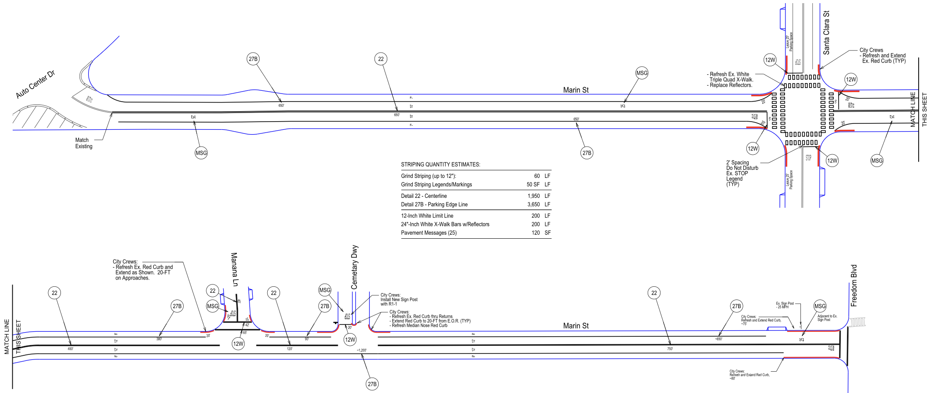
Roadway Restriping Only Project
Target Completion: Summer 2025
Marin St
Auto Center Drive to Freedom Blvd
Refresh Centerline
Install Edge Lines
Narrow Lanes to Slow Traffic
Red Curb at
All Corners
(State Law)
Refresh Centerline
Install Edge Lines
Narrow Lanes to Slow Traffic

Slide 12
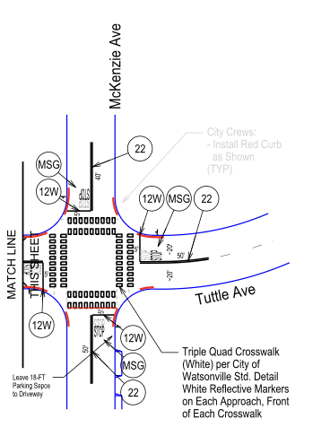
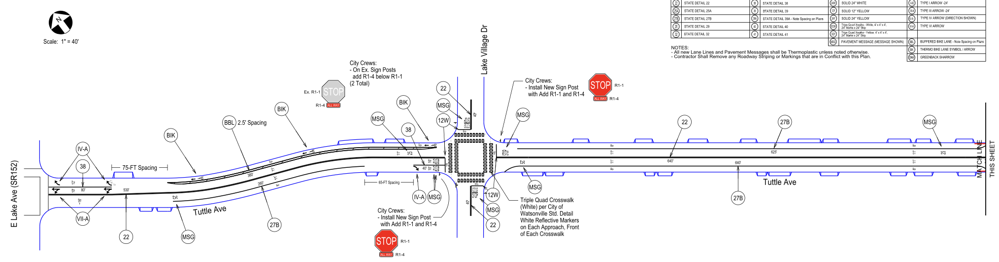
Roadway Restriping Only Project
Target Completion: Summer 2025
Tuttle Ave
E Lake Ave to McKenzie Ave
New All Way STOP
At Lake Village Dr and
Right Lane on Tuttle Ave
Narrow Lanes via
Bike Lane on North
Side of Street
Narrow Lanes via
Parking Edge Lines
Red Curb at
All Corners
(State Law)

Slide 13
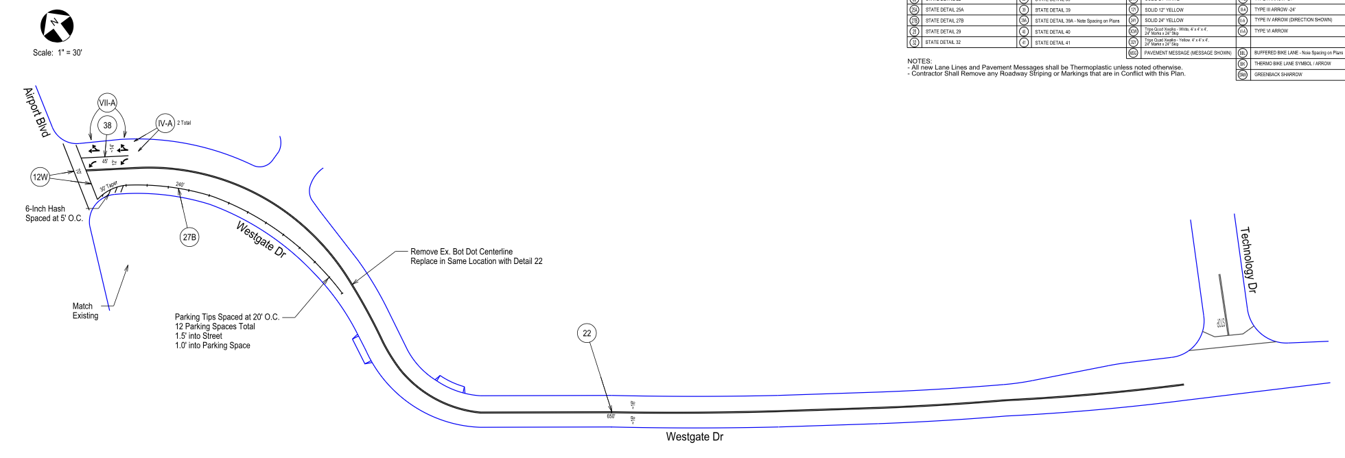
Roadway Restriping Only Project
Target Completion: Summer 2025
Westridge Dr
Airport Blvd to Technology Dr
Refresh Centerline Entire Length
Refresh Parking Edge Line and Add Parking T’s

Slide 14
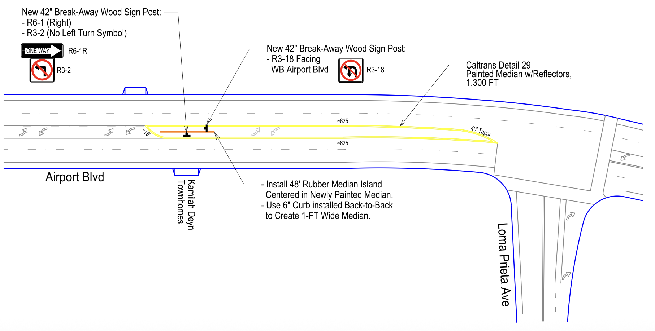
Roadway Restriping Only Project
Target Completion: Summer 2025
Airport Blvd
West of Loma Prieta Ave
Refresh Center Turn Lane
Add Turn Restrictions at East Driveway of New Apartments

Slide 15
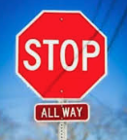
All Way STOP Study Locations 2025
Proposed New All Way STOP Installations
Ohlone Pkwy & Lighthouse Dr
Council District: 1, 4
Lincoln St & E 5th St
Council District: 2, 5
Brewington Ave & California St
Council District: 2, 5, 6
Holm Rd & Jeanette Wy (North)
Council District: 3
Holm Rd & Jeanette Wy (South)
Council District: 3
Lawrence Ave & Anna St
Council District: 3
Palm Ave & Madison St
Council District: 5
Alta Vista Ave & Marilyn St
Council District: 6
Brewington Ave & Logan St
Council District: 6

Slide 16
2024 SS4A Grant Project – Citywide Transportation Study (Funded)
FHWA – Safe Streets for All
Active Transportation Plan
$400,000
-------------
(Grant) $320,000
(Local) $80,000
Citywide Transportation Survey Questionnaire
Technology Standard
Policy Recommendations
Safe Routes to School: School Map and Walk Audits
2. Local Road Safety Plan
Crash History Analysis
Develop Countermeasures with Concept Plans
3. Equity Analysis
Travel Modes
Distribution of Projects around Town
Comparison to Similar Communities

Slide 17
2025 SS4A Grant Project – Speed Cameras & Speed Signs (Proposal Pending)
FHWA – Safe Streets for All
New Grant Proposal Submittal
$750,000
-------------
(Grant) $600,000
(Local) $150,000
Four (4) Speed Cameras
- Green Valley Blvd (2)
- Freedom Blvd (2)
Two (2) Portable Speed and Message Signs
- Use along Routes to School

Slide 18
QUESTIONS & COMMENTS

